Slide 1
Digital Portfolio
STUDENT NAME: Nishanth. N
REGISTER NO AND NMID: 24134120500121017
DEPARTMENT: BCA
COLLEGE: kalaimahal arts and science college
UNIVERSITY: Annamai university
NM. ID:autanm41241224ubca004

Slide 2
PROJECT TITLE
Student portfolio website

Slide 3


AGENDA
Problem Statement
Project Overview
End Users
Tools and Technologies
Portfolio design and Layout
Features and Functionality
Results and Screenshots
Conclusion
Github Link
3/21/2024 Annual Review

Slide 4

PROBLEM STATEMENT
A Student Portfolio Website serves as an online resume that allows students to present their personal information, education, skills, projects, and achievements in an interactive and user-friendly way. The website must be responsive so that it works on desktops, tablets, and mobile devices, and should include smooth navigation, animations, and a contact section to reach potential recruiters or faculty members.

Slide 5

PROJECT OVERVIEW
The Student Portfolio Website is a personal web-based application designed to showcase a student’s academic background, technical skills, and project accomplishments in a professional and interactive manner. This portfolio acts as a digital resume, allowing easy access to information for teachers, recruiters, and peers.

Slide 6

WHO ARE THE END USERS?
1. Students – To showcase their skills, projects, and achievements. 2. Teachers/Faculty – To review student’s academic and project details. 3. Recruiters/Employers – To evaluate for jobs and internships. 4. Peers/Public – To view and get inspiration.

Slide 7
TOOLS AND TECHNIQUES
HTML5 – Structure CSS3 – Styling & responsive design JavaScript – Interactivity & animations VS Code / Notepad++ – Editor Browser (Chrome/Firefox) – Testing GitHub (optional) – Hosting/version control

Slide 8
Techniques
Responsive Web Design Smooth scrolling & animations Modular coding (HTML, CSS, JS separately) Contact form integration User-friendly design

Slide 9
POTFOLIO DESIGN AND LAYOUT
The Student Portfolio Website is designed with a simple and responsive layout. The Home page shows the student’s name and introduction. The About section highlights profile and career goals, while the Education section lists academic details. The Skills section displays technical and soft skills, and the Projects section presents student work. The Contact section allows communication through email or form, and the Footer provides copyright and quick links. The layout uses a sticky navbar, smooth scrolling, and animations, making it user-friendly on all devices.
8

Slide 10
FEATURES AND FUNCTIONALITY
In terms of functionality, the website supports responsive design to work on all devices, a sticky navigation bar for easy access, and smooth scrolling with animations for better user experience. These features make the portfolio professional, interactive, and effective in showcasing the student’s profile.

Slide 11
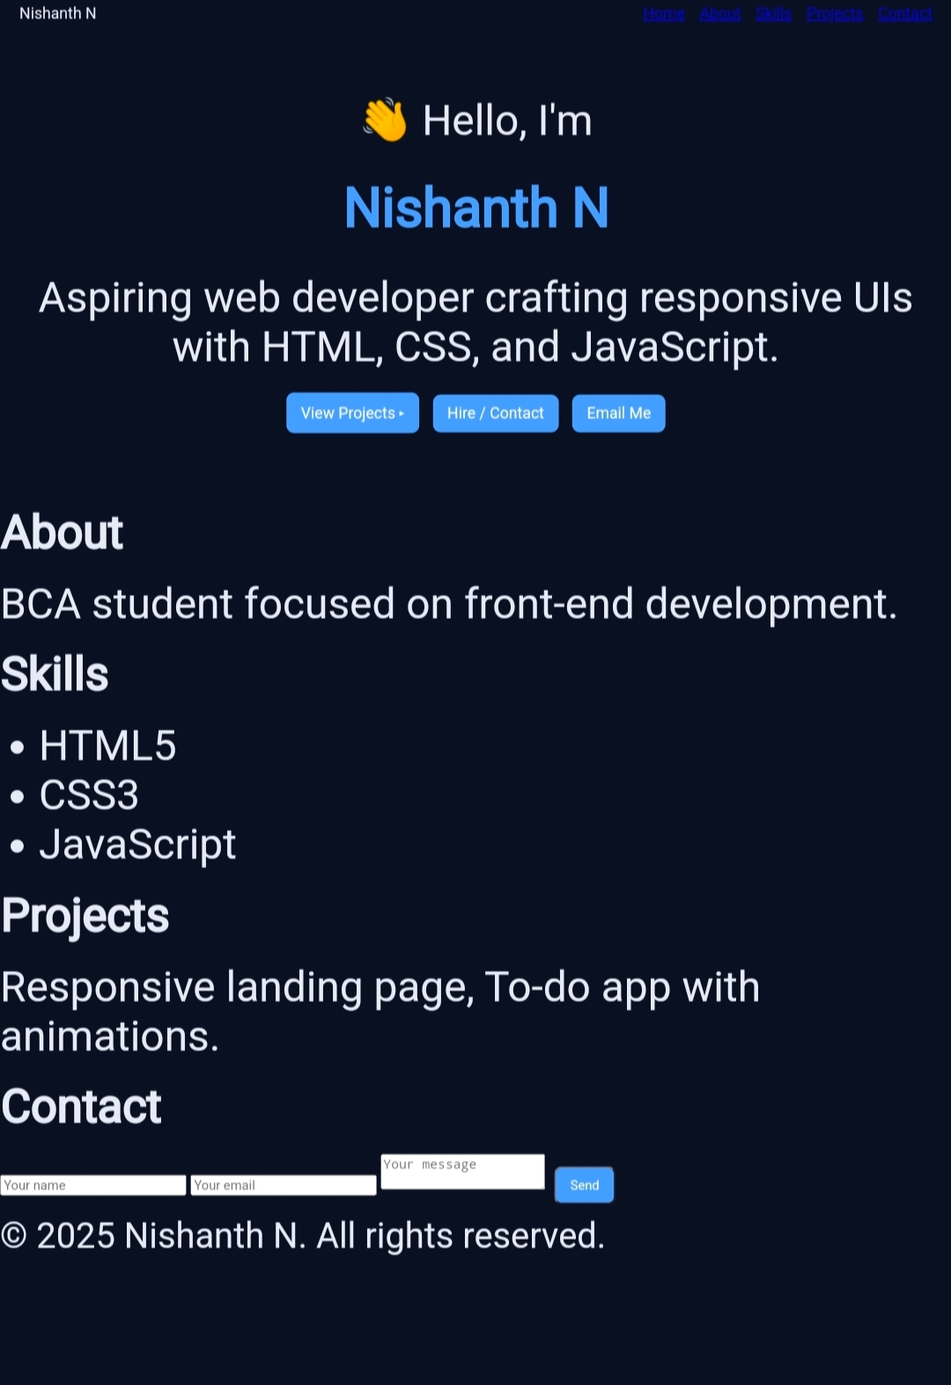

RESULTS AND SCREENSHOTS
Screenshots of the developed website include the Home page with introduction, About page with career goals, Education details, Skills section, Projects showcase, and Contact page. These screenshots highlight the working design and confirm that the objectives of the project were achieved successfully.
3/21/2024 Annual Review
10

Slide 12
CONCLUSION
The Student Portfolio Website was developed successfully using HTML, CSS, and JavaScript. It is a responsive, user-friendly, and professional platform that showcases the student’s details such as profile, education, skills, and projects. With features like a sticky navbar, smooth scrolling, and animations, the site provides a good user experience on all devices. The project achieved its main goal of helping students present their achievements effectively and serves as a useful tool for personal branding and career growth
11

